Slide 1
Machine Learning
Pradyumn Sharma
Pragati Software Pvt. Ltd.
www.pragatisoftware.com
pradyumn.sharma@pragatisoftware.com
???.??.??

Slide 2
Acknowledgements
Many examples, diagrams, and even code snippets have been taken (as is, or with some modifications) primarily from the following sources:
scikitlearn.org
Machine Learning course by Andrew Ng on coursera.org
en.wikipedia.org
kaggle.com

Slide 3
What is Machine Learning?
Giving computers the ability to learn without being explicitly programmed with some knowledge.
A computer program is said to learn from experience E with respect to some task T and some performance measures P, if its performance on T as measured by P improves with experience E.

Slide 4
Machine Learning Prerequisites
Machine Learning is more about Maths than about Python or any libraries. More specifically, at least some basics of :
Linear algebra
Calculus
Probability
Statistics
https://www.youtube.com/watch?v=tGyfmzuR4d4&t=5s

Slide 5
Some Terminology
Supervised learning
Linear Regression (e.g., predict price of a house)
Logistic Regression / Classification (e.g., is a tumour malignant?)
Unsupervised learning
Clustering (relate news items)
Non-clustering (separate different voices in a crowded room)

Slide 6
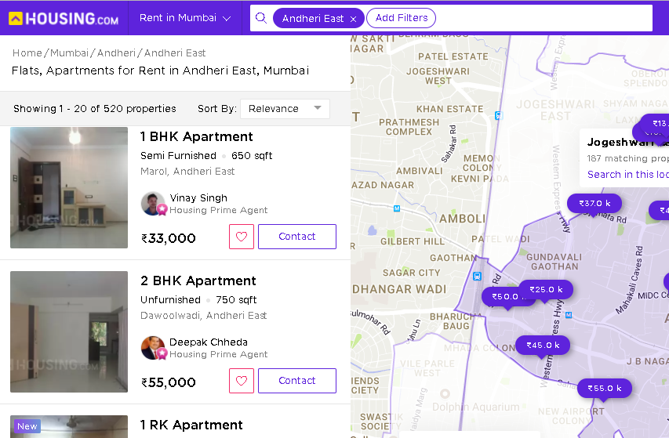
Rentals in Andheri East, Mumbai
Source: www.housing.com
27-Oct-2017

Slide 7
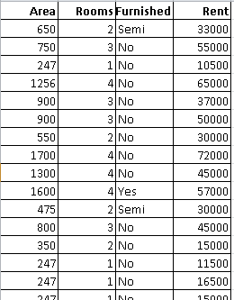
Rentals in Andheri East, Mumbai

Slide 8
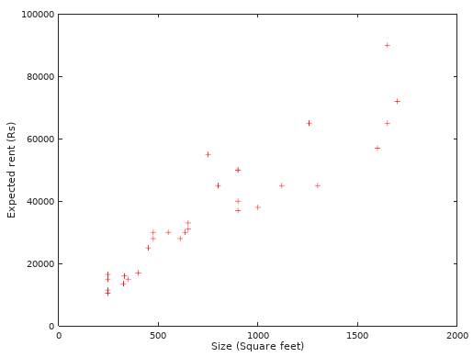
Area x Rent

Slide 9
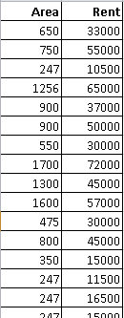
Univariate Linear Regression
Linear regression with one input variable

Slide 10
Notation
x = area of a house
y = rent
(x, y) = one training example
(x^{(i)}, y^{(i)}) = i-th training example
m = number of training examples

Slide 11
Learning Algorithm
Training set
Learning Algorithm
Size of house (x)
Hypothesis
(h)
Expected Rent (y)

Slide 12
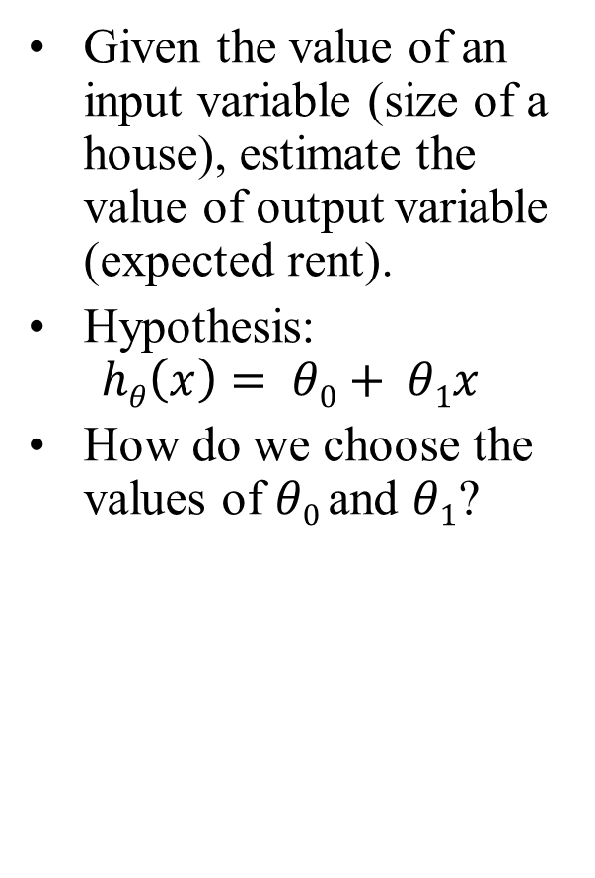
Hypothesis
Given the value of an input variable (size of a house), estimate the value of output variable (expected rent).
Hypothesis: $hθ\left(x\right)= θ0+ θ1x$
How do we choose the values of $θ0$and $θ1$?

Slide 13
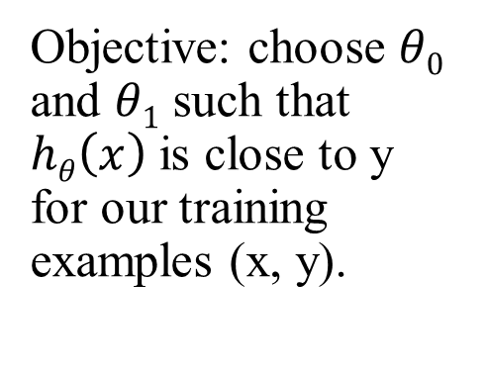
Hypothesis
Objective: choose $θ0$ and $θ1$ such that $hθ\left(x\right)$ is close to y for our training examples (x, y).

Slide 14
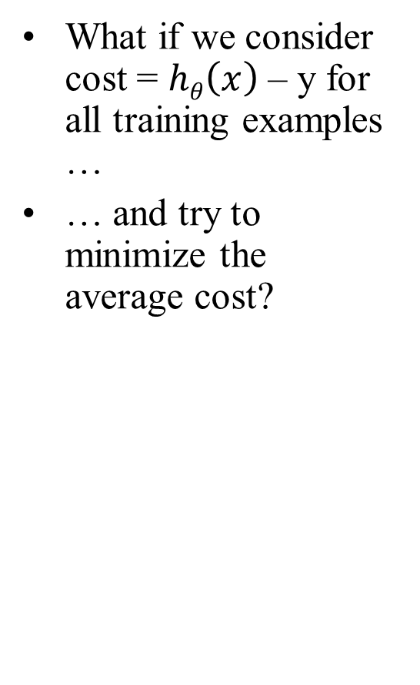

Cost Function: One Candidate
What if we consider cost = $hθ\left(x\right)$ – y for all training examples …
… and try to minimize the average cost?
$$J\left(θ_{0}, θ_{1}\right) =\frac{1}{m}\sum_{i=1}^{m}{\left(h_{θ}\left(x^{\left(i\right)}\right) − y^{(i)}\right)}$$

Slide 15
Cost Function Formula
That, as we can see, can give us poorly fitting lines.

Slide 16

Lab: Manually Regressing, Using MS Excel
Open the file Rentals_WorkingFile.xls
“Raw data” sheet has, well, the raw data, with one input variable (size), and one output variable (rent).
In sheet “Step 1”:
Enter the formula for cost
Play around with different values of $θ0$ and $θ1$, and see the impact on average cost.

Slide 17
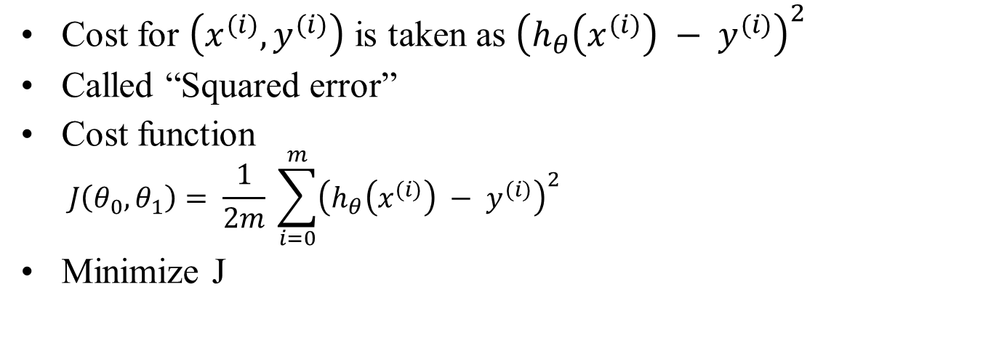
Alternative Cost Function
Cost for $\left(x^{(i)}, y^{(i)}\right)$ is taken as ${\left(h_{θ}\left(x^{(i)}\right) − y^{(i)}\right)}^{2}$
Called “Squared error”
Cost function
$$J\left(θ_{0}, θ_{1}\right)= \frac{1}{2m} \sum_{i=0}^{m}{{\left(h_{θ}\left(x^{(i)}\right) − y^{(i)}\right)}^{2}}$$
Minimize J

Slide 18

Lab: Manually Regressing, Using MS Excel
Step 2:
put in formula for cost, play around with values of $θ0$ and $θ1$, and see the impact on average cost.
with the same formula for cost, and a fixed value for $θ0$, and varying values $θ1$, see the impact on average cost in data table.

Slide 19
Impact of Changes in $θ_{1}$on J($θ_{1}$)

Slide 20

Impact of Changes in $θ_{0}$and $θ_{1}$on J($θ_{0}$, $θ_{1}$)
Image source:
http://www.heavenlyhammocks.co.za/product_info.php?products_id=30

Slide 21
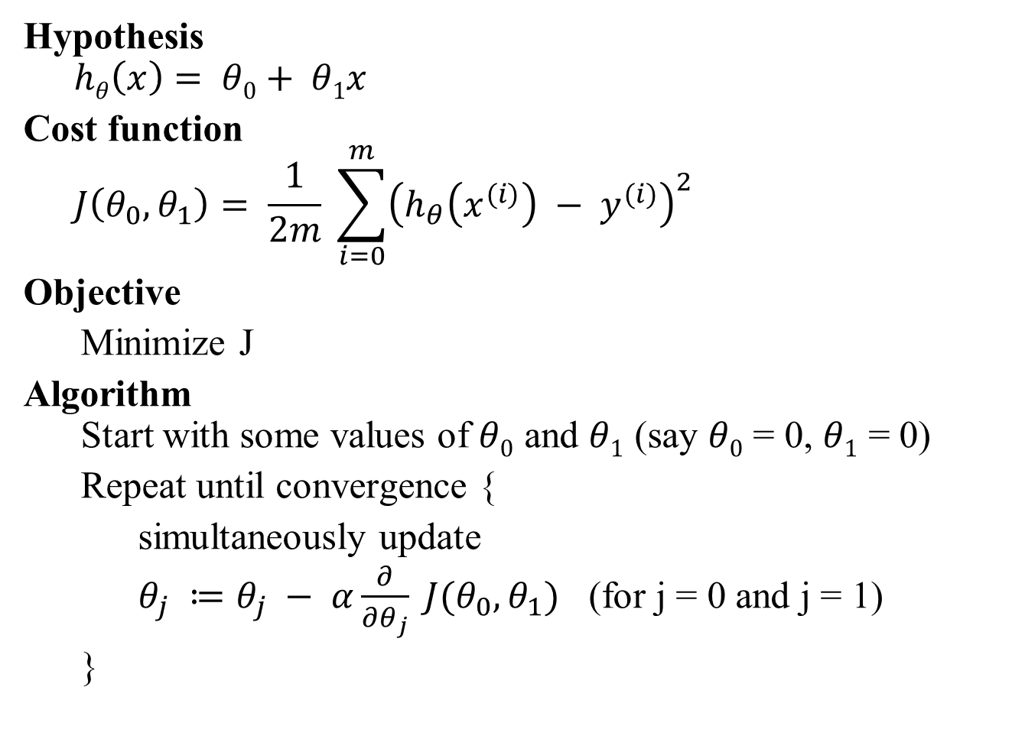
Gradient Descent
Hypothesis
$$hθ\left(x\right)= θ0+ θ1x$$
Cost function
$$J\left(θ_{0}, θ_{1}\right)= \frac{1}{2m} \sum_{i=0}^{m}{{\left(h_{θ}\left(x^{(i)}\right) − y^{(i)}\right)}^{2}}$$
Objective
Minimize J
Algorithm Start with some values of $θ0$ and $θ1$ (say $θ0$ = 0, $θ1$ = 0)
Repeat until convergence {
simultaneously update
$θ_{j} ≔θ_{j} − α\frac{∂}{∂θ_{j}} J(θ_{0}, θ_{1})$ (for j = 0 and j = 1)
}

Slide 22
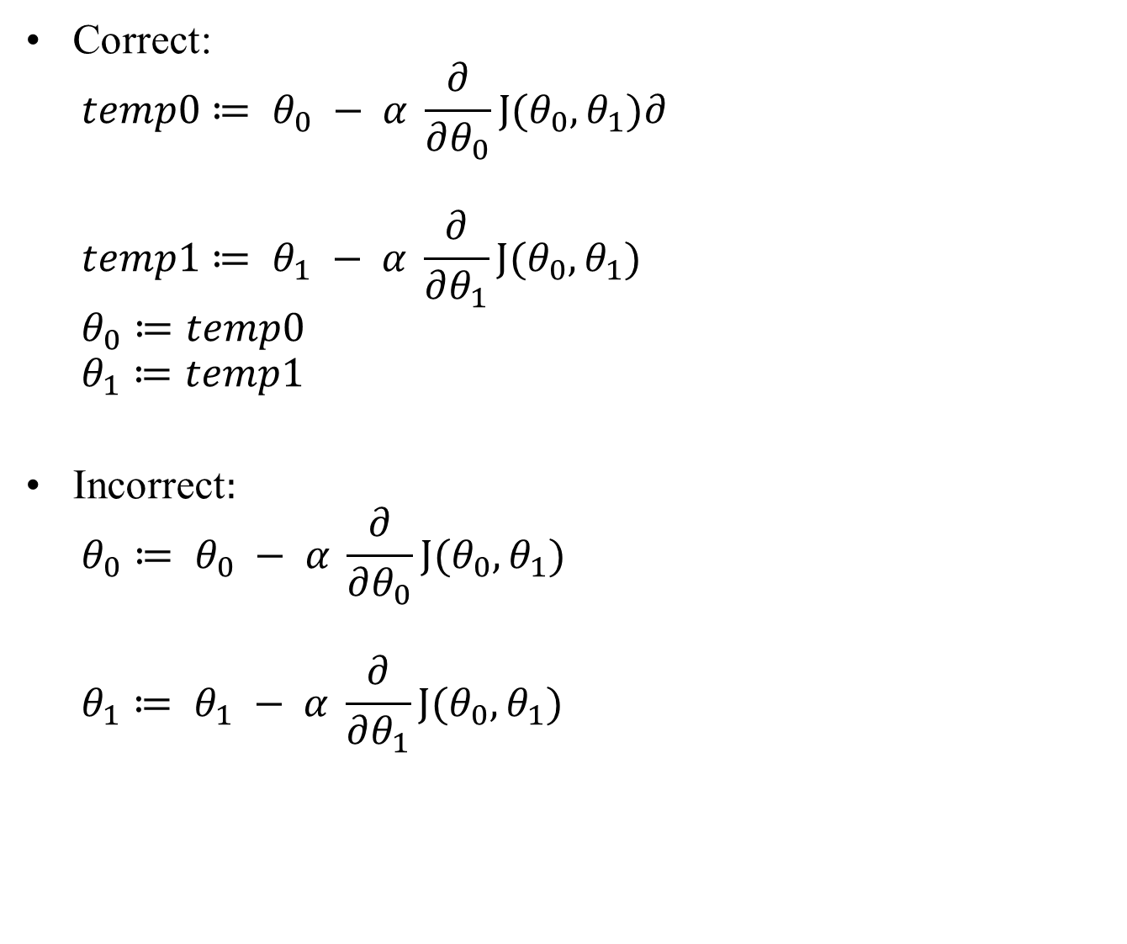
Simultaneous Updates
Correct:
$$temp0≔ θ_{0} − α \frac{∂}{∂θ_{0}}J(θ_{0},θ_{1})∂$$
$$temp1≔ θ_{1} − α \frac{∂}{∂θ_{1}}J(θ_{0},θ_{1})$$
$$θ_{0}≔temp0$$
$$θ_{1}≔temp1$$
Incorrect$:$
$$θ_{0}≔ θ_{0} − α \frac{∂}{∂θ_{0}}J(θ_{0},θ_{1})$$
$$θ_{1}≔ θ_{1} − α \frac{∂}{∂θ_{1}}J(θ_{0},θ_{1})$$

Slide 23
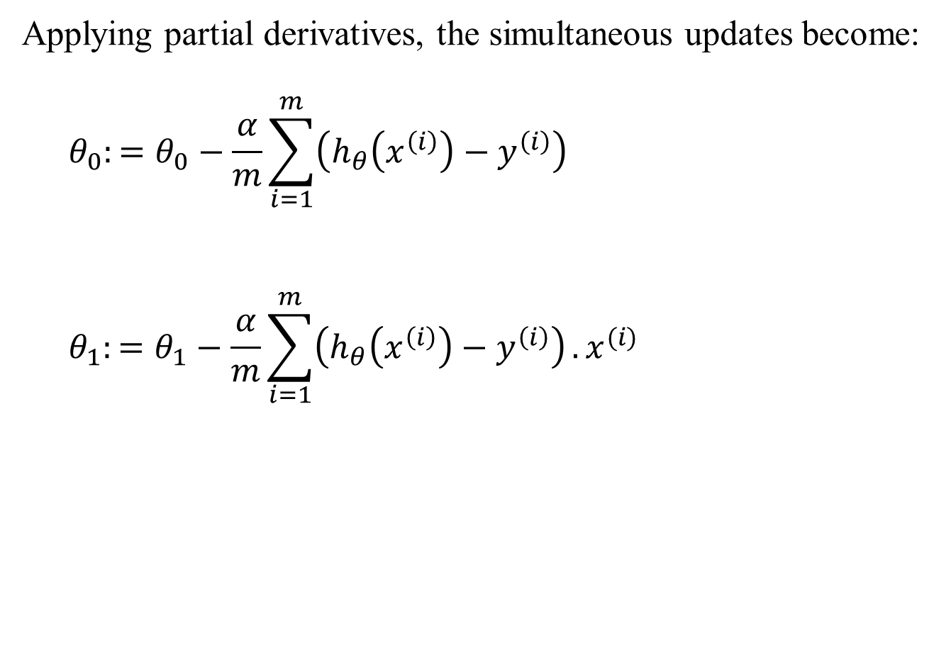
Simultaneous Updates
Applying partial derivatives, the simultaneous updates become:
$$θ_{0}:=θ_{0}−\frac{α}{m}\sum_{i=1}^{m}{\left(h_{θ}\left(x^{\left(i\right)}\right)−y^{\left(i\right)}\right)}$$
$$θ_{1}:=θ_{1}−\frac{α}{m}\sum_{i=1}^{m}{\left(h_{θ}\left(x^{\left(i\right)}\right)−y^{\left(i\right)}\right)}.x^{(i)}$$

Slide 24
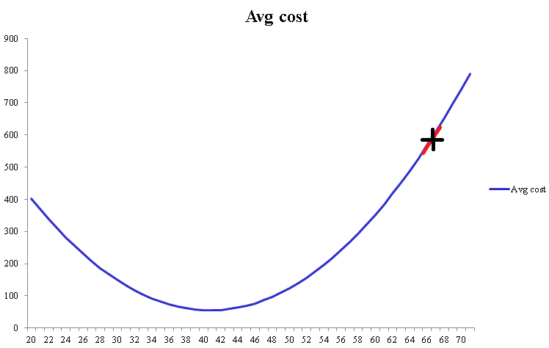
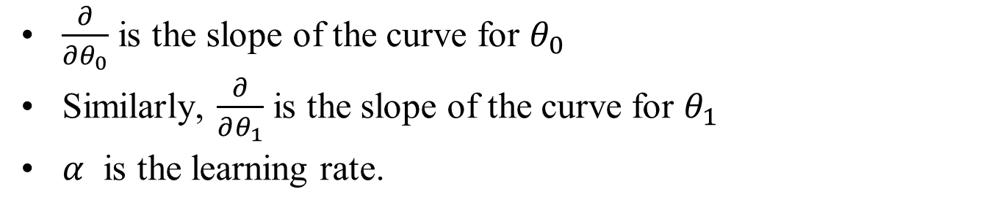
What are $α$and $\frac{∂}{∂θ_{0}}$
$\frac{∂}{∂θ_{0}}$ is the slope of the curve for $θ_{0}$
Similarly, $\frac{∂}{∂θ_{1}}$ is the slope of the curve for $θ_{1}$
$α$ is the learning rate.

Slide 25

Lab: Gradient Descent using MS Excel
In the sheet titled “Step 3”:
Start with some $θ_{0}$and $θ_{1}$, $α$
Put in formulas for estimate, cost, error, error * x
Put in formulas for average error, average (error * x)
Manually run a few iterations of gradient descent logic, and see the impact on the chart plotted

Slide 26

Lab: Gradient Descent using Java
Run the Java program provided to you for Gradient Descent.
Tinker with the values of $θ_{0}$, $θ_{1}$, $α$, iterations, and see the impact on results.

Slide 27

Learning Rate ($α$)
If $α$is too small, gradient descent can be too slow.
If $α$is too large, gradient descent can overshoot the minimum and fail to converge, or may even diverge.

Slide 28
Linear Algebra

Slide 29
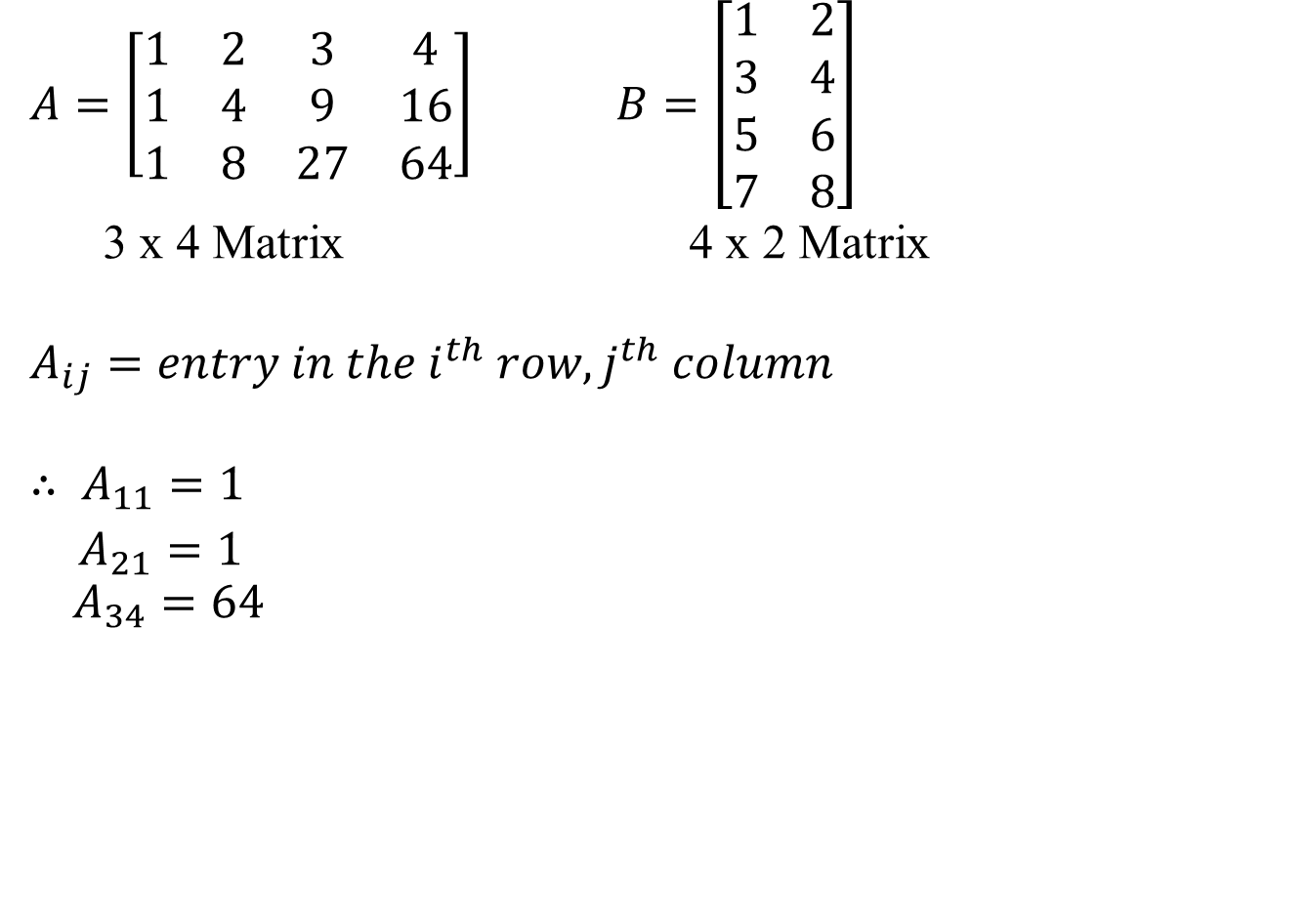
Matrices
$A=\left[\begin{matrix}1 & 2 & 3 & 4 \\ 1 & 4 & 9 & 16 \\ 1 & 8 & 27 & 64\end{matrix}\right]$ $B=\left[\begin{matrix}1 & 2 \\ 3 & 4 \\ 5 & 6 \\ 7 & 8\end{matrix}\right]$
3 x 4 Matrix 4 x 2 Matrix
$$A_{ij}=entry in the i^{th} row, j^{th} column$$
$$∴ A_{11}=1$$
$A_{21}=1$
$$A_{34}=64$$

Slide 30

Vectors
$$y=\left[\begin{matrix}5 \\ 10 \\ 15 \\ \begin{aligned}20 \\ 25\end{aligned}\end{matrix}\right]$$
Vector: n x 1 matrix
$$y_{i}=i^{th} element$$
$$y_{4}=20$$

Slide 31

Matrix Addition
$\left[\begin{matrix}1 & 2 \\ 11 & 12 \\ 21 & 22\end{matrix}\right]$ + $\left[\begin{matrix}1 & 2 \\ 3 & 4 \\ 5 & 6\end{matrix}\right]$ = $\left[\begin{matrix}2 & 4 \\ 14 & 16 \\ 26 & 28\end{matrix}\right]$
$\left[\begin{matrix}1 & 2 \\ 11 & 12 \\ 21 & 22\end{matrix}\right]$ + $\left[\begin{matrix}1 & 2 & 3 \\ 4 & 5 & 6 \\ 7 & 8 & 9\end{matrix}\right]$ = $error$

Slide 32

Scalar Multiplication
$$5 x \left[\begin{matrix}1 & 2 \\ 3 & 4 \\ 5 & 6\end{matrix}\right]= \left[\begin{matrix}5 & 10 \\ 15 & 20 \\ 25 & 30\end{matrix}\right]$$

Slide 33
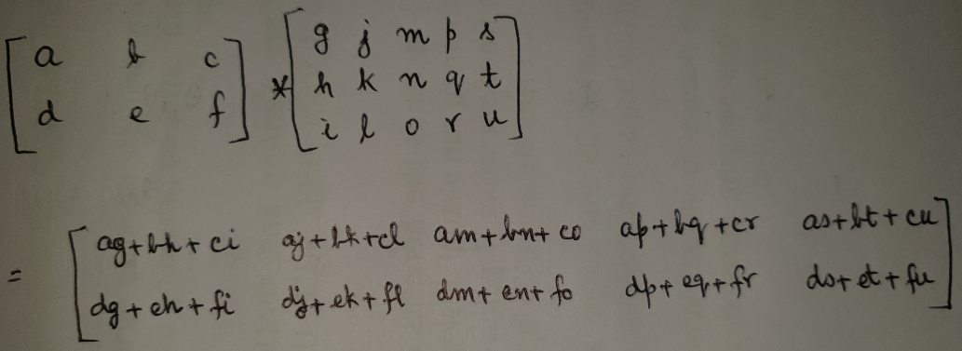
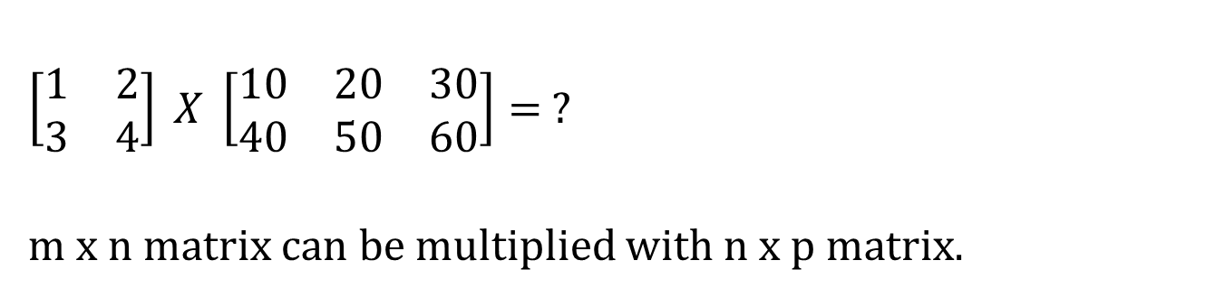
Matrix x Matrix Multiplication
$$\left[\begin{matrix}1 & 2 \\ 3 & 4\end{matrix}\right] X \left[\begin{matrix}10 & 20 & 30 \\ 40 & 50 & 60\end{matrix}\right]= ?$$
m x n matrix can be multiplied with n x p matrix.

Slide 34
Matrix x Vector Multiplication
Figure out yourself

Slide 35

Matrix x Matrix Multiplication Properties
Non-commutative.
$$A ∗ B ≠B ∗ A$$
$$\left[\begin{matrix}1 & 2 \\ 3 & 4\end{matrix}\right]\left[\begin{matrix}5 & 6 \\ 7 & 8\end{matrix}\right]=\left[\begin{matrix}19 & 24 \\ 43 & 50\end{matrix}\right]$$
$\left[\begin{matrix}5 & 6 \\ 7 & 8\end{matrix}\right]$ $\left[\begin{matrix}1 & 2 \\ 3 & 4\end{matrix}\right]$ = $\left[\begin{matrix}23 & 34 \\ 31 & 56\end{matrix}\right]$

Slide 36
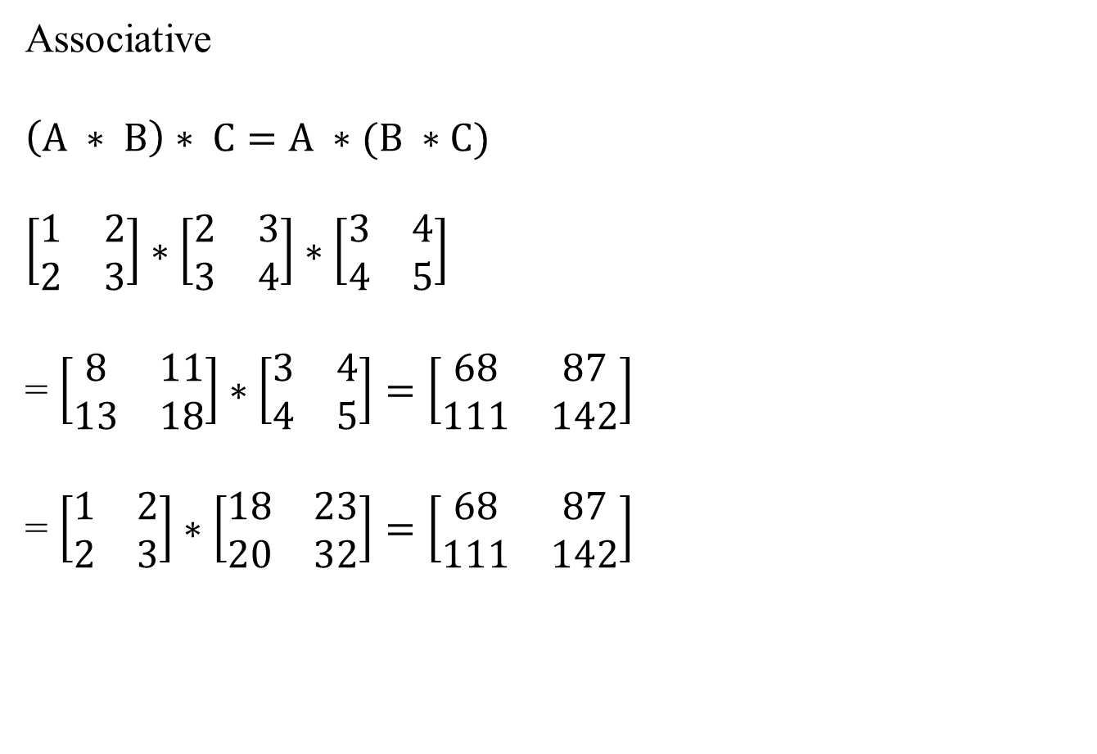
Matrix x Matric Multiplication Properties
Associative
$$\left(A ∗ B\right)∗ C=A ∗(B ∗C)$$
$$\left[\begin{matrix}1 & 2 \\ 2 & 3\end{matrix}\right]∗\left[\begin{matrix}2 & 3 \\ 3 & 4\end{matrix}\right]∗\left[\begin{matrix}3 & 4 \\ 4 & 5\end{matrix}\right]$$
= $\left[\begin{matrix}8 & 11 \\ 13 & 18\end{matrix}\right]∗\left[\begin{matrix}3 & 4 \\ 4 & 5\end{matrix}\right]=\left[\begin{matrix}68 & 87 \\ 111 & 142\end{matrix}\right]$
= $\left[\begin{matrix}1 & 2 \\ 2 & 3\end{matrix}\right]∗\left[\begin{matrix}18 & 23 \\ 20 & 32\end{matrix}\right]=\left[\begin{matrix}68 & 87 \\ 111 & 142\end{matrix}\right]$

Slide 37

Identity Matrix
$$I or I_{n X n}$$
$\left[\begin{matrix}1 & 0 \\ 0 & 1\end{matrix}\right]$, $\left[\begin{matrix}1 & 0 & 0 \\ 0 & 1 & 0 \\ 0 & 0 & 1\end{matrix}\right]$
For any matrix A (using an appropriately sized Identify Matrix),
$$A.I=I. A=A$$

Slide 38
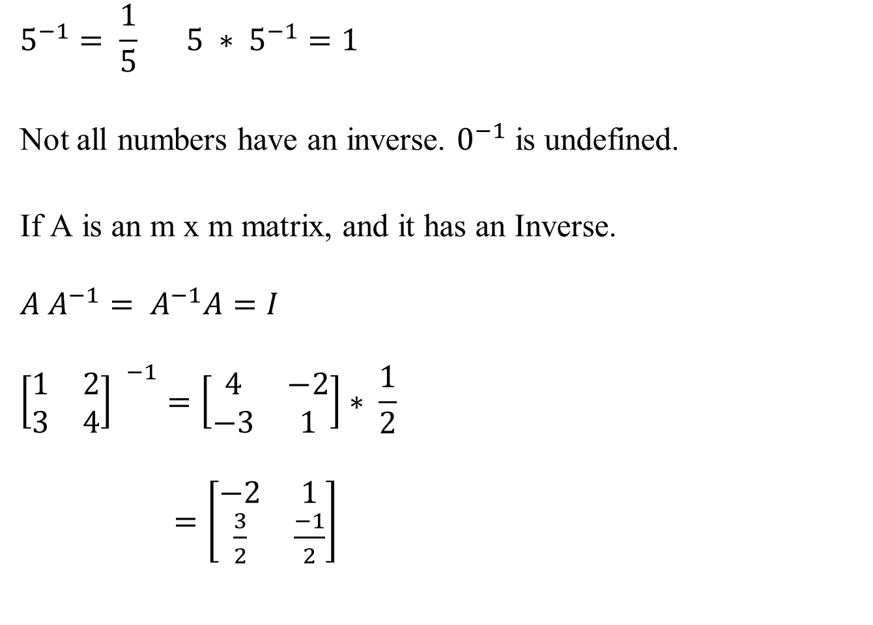
Inverse of a Matrix
$$5^{−1}= \frac{1}{5} 5 ∗ 5^{−1}=1$$
Not all numbers have an inverse. $0^{−1}$ is undefined.
If A is an m x m matrix, and it has an Inverse.
$$A A^{−1}= A^{−1}A=I$$
$${\left[\begin{matrix}1 & 2 \\ 3 & 4\end{matrix}\right] }^{−1}=\left[\begin{matrix}4 & −2 \\ −3 & 1\end{matrix}\right]∗ \frac{1}{2}$$
$=\left[\begin{matrix}−2 & 1 \\ \frac{3}{2} & \frac{−1}{2}\end{matrix}\right]$

Slide 39

Transpose of a Matrix
$$A= \left[\begin{matrix}1 & 2 & 3 \\ 4 & 5 & 6\end{matrix}\right]$$
$$A^{T}= \left[\begin{matrix}1 & 4 \\ 2 & 5 \\ 3 & 6\end{matrix}\right]$$

Slide 40
Getting Started with ML in Python

Slide 41
Setup Instructions
Install Python.
Download libraries: pandas, numpy, scikit-learn.
Download jupyter.
We’ll use jupyter notebook for browser-based, incremental execution of commands.
Use any text editor for editing the source files (such as Sublime Text).

Slide 42
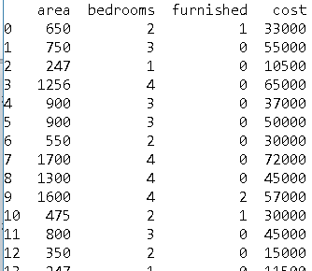
The Basics
Copy the file “rentals.csv” to your computer.
Start writing the code in jupyter notebook or any text editor.
import pandas
full_data = pandas.read_csv ("./rentals.csv")
print (full_data)

Slide 43
Pandas
Pandas (pandas.pydata.org) is an open-source library that provides data structures and data analysis tools.
http://pandas.pydata.org/pandas-docs/stable/getting_started/10min.html: 10 minutes to Pandas.

Slide 44
Some Panda Commands
full_data
full_data.dtypes
full_data.head()
full_data.head(10)
full_data.tail()
full_data.tail(10)
full_data.columns
full_data.describe()
full_data.T
full_data.sort_values(by="cost")
full_data.cost
full_data[“cost”] -- same as full_data.cost

Slide 45
Some More Panda Commands
full_data[0:5]
full_data[:5]
full_data[3:6]
full_data.loc[3:6]
full_data.loc[:, ["area", "cost"]]
y = full_data.loc[:, ["area", "cost"]]
full_data.loc[3:6, ["area", "cost"]]
full_data.iloc[3]
full_data.iloc[3:6,1:3]
full_data.iloc[:, [0,3]]
full_data.iloc[1,1]
full_data.at[1,"bedrooms"]=11
full_data.iat[1, 1]=22

Slide 46
Some More Panda Commands
full_data.mean()
fd = full_data
fd
fd.mean(0)
fd.to_csv("./junk.txt")
pandas.read_excel("./junk.xlsx", sheet_name = "Raw data")

Slide 47
Understanding the Data
print('\nfull_data :: \n',full_data.shape)
print('\nfull_data.head :: \n',full_data.head())
print('\nfull_data.tail :: \n',full_data.tail())
print('\nfull_data.describe :: \n',full_data.describe())
from pandas.plotting import scatter_matrix
full_data.plot(kind='box',subplots=True,layout=(2,2),sharex=False,sharey=False)
scatter_matrix(full_data)

Slide 48
Linear Regression

Slide 49
Stochastic Gradient Descent
Stochastic = having a random probability distribution that may be analyzed statistically but may not be predicted precisely.

Slide 50
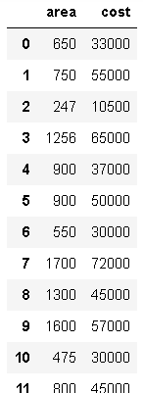
Extracting the Required Columns
rentals = pandas.DataFrame ({'area':fd.area,'cost':fd.cost})

Slide 51
scikit-learn
Open-source, Machine Learning library in Python.
https://scikit-learn.org/stable/index.html

Slide 52
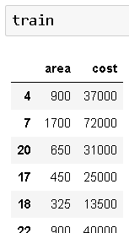
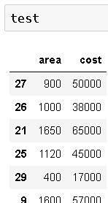
Training and Testing Set Split
from sklearn.model_selection import train_test_split
train, test = train_test_split (rentals, test_size=0.2)

Slide 53
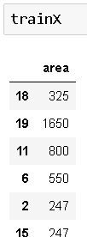
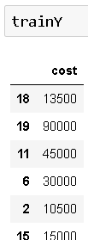

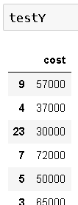
Separating Features (x) and Results (y)
trainX = pandas.DataFrame ({'area': train['area']})
trainY = pandas.DataFrame ({'cost': train['cost']})
testX = pandas.DataFrame ({'area': test['area']})
testY = pandas.DataFrame ({'cost': test['cost']})

Slide 54
Alternative Splitting
dataX = pandas.DataFrame ({'area':full_data.area})
dataY = pandas.DataFrame ({'cost':full_data.cost})
from sklearn.model_selection import train_test_split
trainX, testX, trainY, testY = train_test_split(dataX, dataY,test_size = 0.20, random_state = 11)

Slide 55
SGDRegressor
Stochastic Gradient Descent Regressor.
A simple and efficient algorithm for linear regression.
Scales very well for very large datasets (such as 10^5 rows) and very large number of features (such as 10^5).

Slide 56
Defining the Model
# define the model
from sklearn.linear_model import SGDRegressor
reg = SGDRegressor()

Slide 57
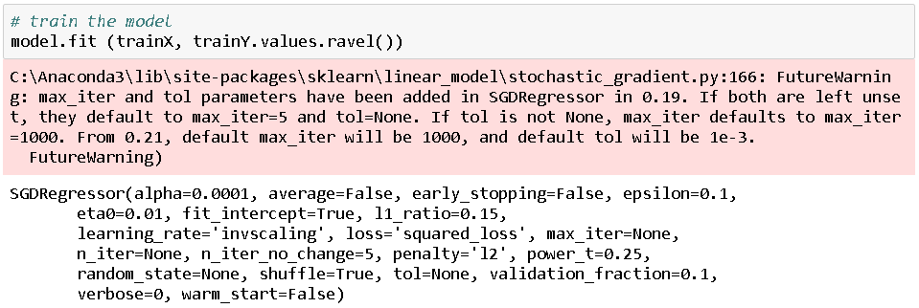
Training the Model
# train the model
reg.fit (trainX, trainY.values.ravel())

Slide 58
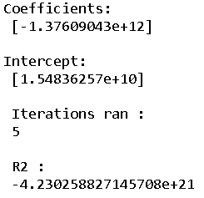
Evaluating the Results
print ('Coefficients: \n', reg.coef_)
print ('Intercept: \n', reg.intercept_)
print('\n iterations ran : \n',reg.n_iter_);
print (reg.score (testX, testY))

Slide 59
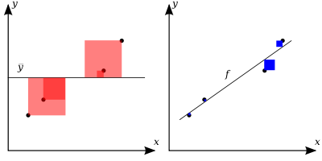
R-Squared (Coefficient of Determination)
CoD: a measure of how much change in output variable (y) is explained by changes in the input variable (x)
If the actual values of the dependent variable are y1, y2, … yn,
And the predicted values are f1, f2, … fn

Slide 60
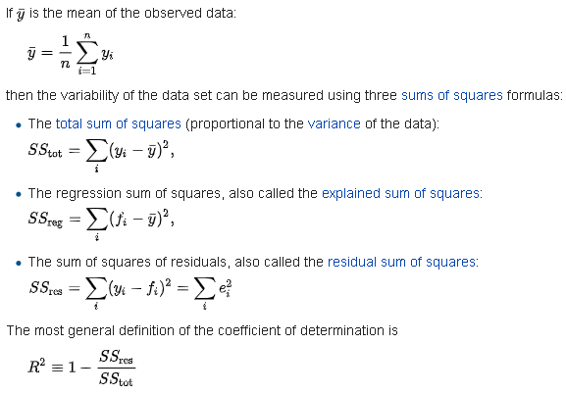
Coefficient of Determination

Slide 61
Making Gradient Descent Work Well
Tweak eta0 (learning rate)
Observe changes in J after each iteration (with verbose = 1), and if required, change eta0, max_iter, tol.
tol: tolerance; if the change in the cost function between iterations is smaller than this value, no more iterations are run.
shuffle: True or False. Default is True. If True, the data is shuffled in each iteration. This is recommended, but initially, to benchmark the results against a standard dataset, you may like to temporarily set it to False.
reg = SGDRegressor(max_iter=1000, eta0=0.0000001, tol=1000, shuffle=False)

Slide 62
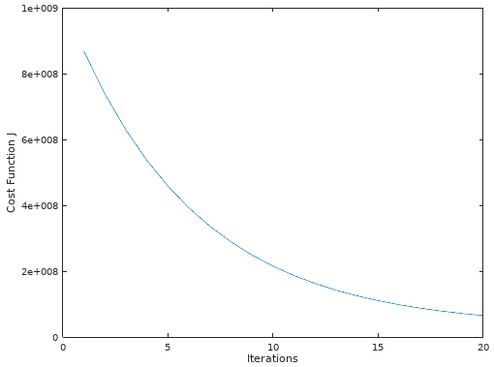
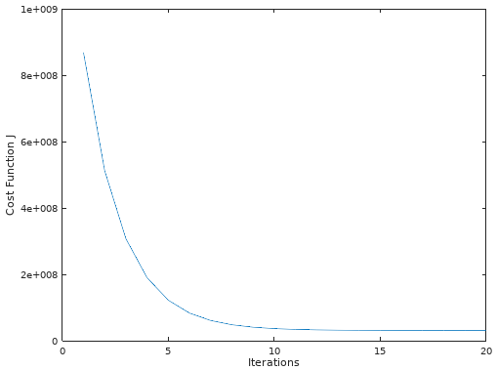
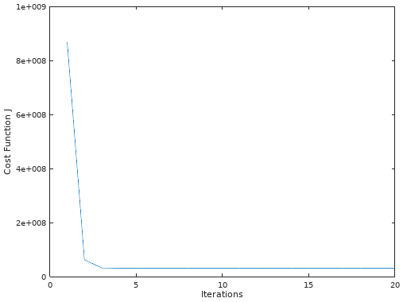
Tweaking Learning Rate
For sufficiently small learning rate, J should decrease on each iteration.
But if it is too small, gradient descent can be slow to converge.

Slide 63
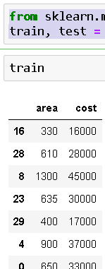
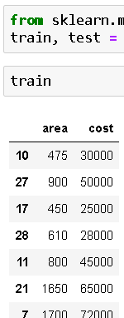
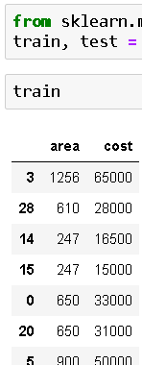
Different Random Splits Every Time

Slide 64
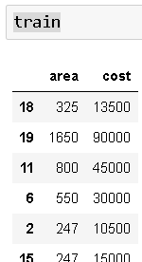
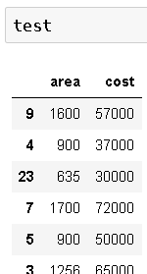
Ensuring Same Split Every Time
from sklearn.model_selection import train_test_split
train, test = train_test_split (rentals, test_size=0.2, random_state = 9)

Slide 65
Making Predictions
# predict for the test data
yhat = reg.predict (testX)
result = pandas.DataFrame({'predictions': yhat, 'actual': testY.values[:,0]})
print (result.head(10))

Slide 66
Predictions for User-Supplied Data
choice = 'y'
while choice == 'y':
area = input('\nEnter Area :: ')
customTestX = pandas.DataFrame({'area': area }, index=[0])
yhat = model.predict (customTestX)
print('\nPrediction result :: ',yhat)
choice = input('\ndo you want to continue ? y-n :: ')

Slide 67
Model Properties
from sklearn.metrics import mean_squared_error, r2_score
print ('Mean squared error: \n', mean_squared_error (testY, yhat))
print ('Variance score: \n', r2_score (testY, yhat))

Slide 68
Exercises
Apply Gradient Descent using number of bedrooms also.
Apply Gradient Descent for diabetes dataset.

Slide 69
Feature Scaling
Making sure that the features are on a similar scale.
Example:
X1 (area) from 0 – 2000
X2 (bedrooms) from 0 – 5
Convert
X1 = area / 2000
X2 = bedrooms / 5
What is the range of values of the new factors?

Slide 70

Common Techniques of Feature Scaling
Data normalization (mean normalization)
X1 = area – average (area) / 2000.
Approximate range?
Data standardization
Shifting the distribution of each attribute to have a mean of zero, and a standard deviation of one.
Approximate range?
Standard deviation

Slide 71
Data Standardization in scikit-learn
from sklearn.preprocessing import StandardScaler
scaler = StandardScaler()
trainX =scaler.fit_transform(trainX)
testX=scaler.fit_transform(testX)

Slide 72
Feature Scaling of User-Supplied Data
choice = 'y'
while choice == 'y':
area = input('\nEnter Area :: ')
bedrooms = input('\nEnter Bedrooms :: ')
customTestX = pandas.DataFrame({'area': area , \
'bedrooms': bedrooms }, index=[0])
yhat = model.predict (scaler.fit_transform \
(customTestX))
print('\nPrediction result :: ',yhat)
choice = input('\ndo you want to continue ? y-n :: ')
print('End')

Slide 73
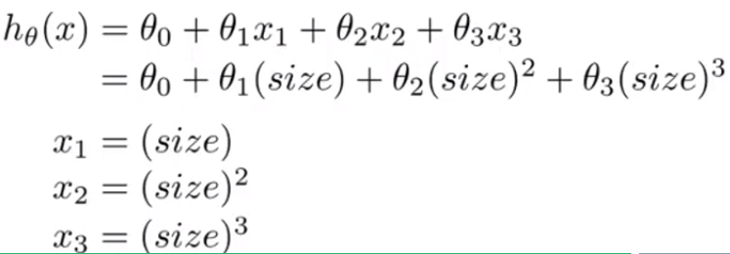
Polynomial Regression
Could rentals depend (better) on:
Spaciousness of house (area / bedrooms)
Bedroom-square
Square root of bedrooms
Other such powers of x?

Slide 74
Polynomial Regression
With higher powers of features, feature scaling becomes even more important.
You can:
Manually generate the required powers of features, or
Use the PolynomialFeatures class from scikit-learn

Slide 75
Manually Computing Polynomial Expressions
import numpy
full_data = pandas.DataFrame ({'area':full_data.area, 'bedrooms':full_data.bedrooms, 'br-square' : full_data.bedrooms * full_data.bedrooms ,'br-root' : numpy.sqrt(full_data.bedrooms) , 'spacious' :full_data.area / full_data.bedrooms , 'cost':full_data.cost})

Slide 76
Generating Polynomial Expressions
from sklearn.preprocessing import PolynomialFeatures
poly = PolynomialFeatures(2)
trainX = poly.fit_transform(trainX)
testX = poly.fit_transform(testX)

Slide 77

Normal Equation Method
An alternative approach to gradient descent.
Method to solve for theta analytically.
$X=\left[\begin{matrix}1 & 650 & 2 \\ 1 & 750 & 3 \\ 1 & 247 & 1\end{matrix}\right]$ y$=\left[\begin{matrix}33000 \\ 55000 \\ 10500\end{matrix}\right]$
$θ={\left(X^{T}θ\right)}^{−1}∗(X^{T}y)$

Slide 78

Comparison
Gradient Descent | Normal Equation
Need to choose$α$ | No need to choose$α$
Needs many iterations | Does not need iterations
Feature scaling improves performance | No need to do feature scaling
Works well even if n is very large | Inverting a (n * n) matrix is O(n^3). Therefore, slow if n is very large.(such as 10,000)
Works well for more sophisticated algorithms such as logistic regression also | Does not work for logistic regression and other more sophisticated algorithms
NA | Some matrices are not invertible; will not work in those cases.

Slide 79
Linear Regression in scikit-learn
The LinearRegression class provides another implementation of the ordinary least squares linear regression.
# define the model
from sklearn.linear_model import LinearRegression
reg = LinearRegression()
# train the model
reg.fit (trainX, trainY)
r2 = reg.score(testX, testY)
print ('r2: \n', r2)

Slide 80
Ridge Regression
Ordinary Least Squares (OLS) regression has the BLUE property
Best
Linear
Unbiased
Estimates
Unbiased?
If we run regression multiple times over different subsets of data, the coefficients are always close to the average of these coefficients across all runs.
In other words, variance in the coefficients is very low.
But if there is high collinearity among the features, the variance in the coefficients becomes high. This is high bias.
Collinearity: the features having high correlation among themselves.

Slide 81

Ridge Regression
How do we eliminate this bias?
We don’t want the coefficients to become too big.
Ridge regression minimizes sum of OLS, such that the sum of squares of coefficients <= c^2 where c is

Slide 82

Ridge Regression

Slide 83

Ridge Regression

Slide 84
Ridge Regression
from sklearn.linear_model import Ridge
model = Ridge (alpha = 1)

Slide 85
Feature Selection
Do all features have a meaningful impact on the outcome? How do we reduce the number of features from the model without a significant impact on the quality of predictions.
This is where Lasso Regression comes in.

Slide 86

Lasso Regression
This is a linear model trained with L1 prior as regularizer.
L1 is the sum of all the coefficients (L2 is the sum of OLS).

Slide 87

Lasso Regression

Slide 88
Lasso Regression
It sparsifies the vector of coefficients. In simpler terms, it makes some coefficients zero if they have a very small impact on the outcome.
from sklearn.linear_model import Lasso
model = Lasso ()

